Slide 1
Bike Sharing Analysis
Presented by: Huong
Last Updated: December 30th, 2024

Slide 2
Table of Content
01
Objective
02
About the data
03
04
Conclusion and Reconmmendation
Analysis
05
Appendix

Slide 3
What are we talking about?

Slide 4

Objective
Identify how annual members and casual riders use Cyclistic bikes differently.

Slide 5
About the data
Cyclistic’s historical trip data
Collected from 2023/12 to 2024/11
The data has been made available by Motivate International Inc.
This is public data that we can use to explore how different customer types are using Cyclistic bikes.
Data-privacy issues prohibit from using riders’ personally identifiable information.
Tools use: SQL, Tableau, Powerpoint
Notes:
This means that we won’t be able to connect pass purchases to credit card numbers to determine if casual riders live in the Cyclistic service area or if they have purchased multiple single passes.

Slide 6
Present the data

Slide 7
User Behavior Analysis

Slide 8
Popular type of ride
Total trips for classic bikes, electric bikes and electric scooters.
Casual bikers prefer electric bikes to classic bikes
Casuals
Members
Notes:
có thể thấy casual dùng nhiều electtric bikes hơn. giá cả? giá electric must be more expensive. nhưng casual chấp nhận maybe là vì dùng 1 lần thì thôi chơi mắc cũng đc, ngoài ra ở

Slide 9
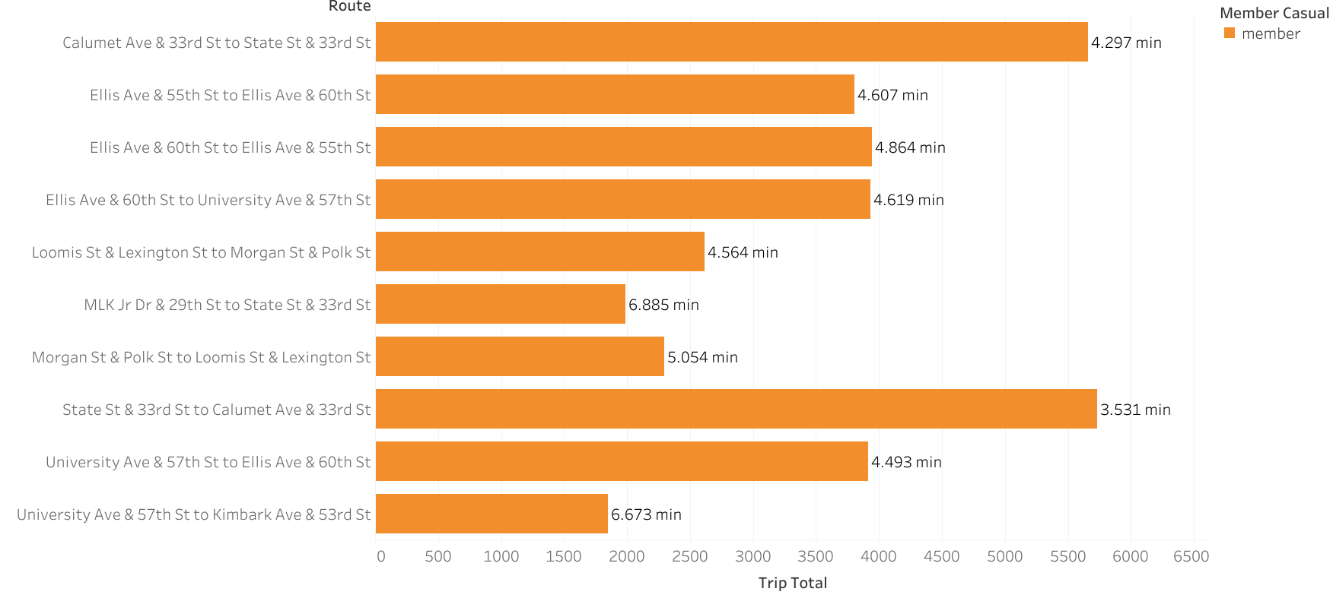
Popular routes for members
Time spent on each trip on this route on average
Notes:
all routes for members are 1 way, casuals are round trips. reflect user behavior: member have a set routine

Slide 10
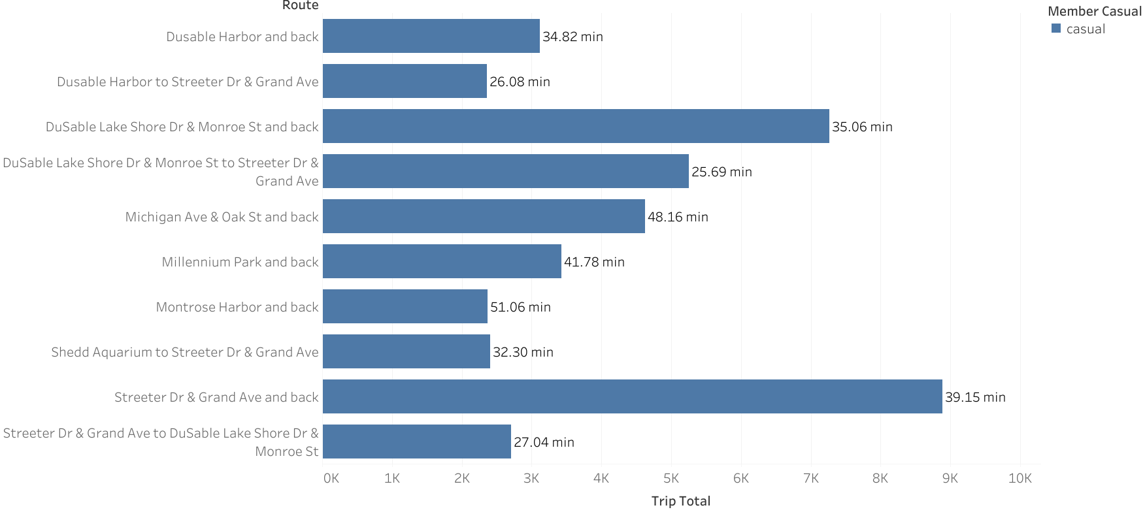
Popular routes for casuals
Casuals spend significantly more time per trip on average compare to members on theirs
Round trip route
Time spent on each trip on this route on average

Slide 11
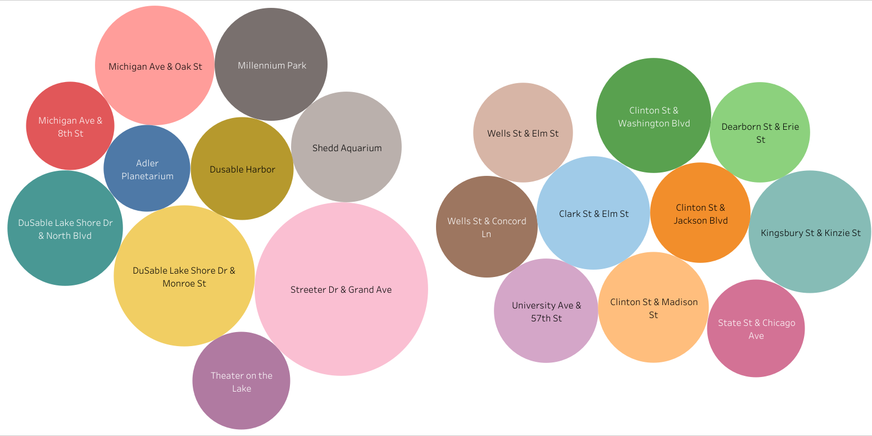
Popular Stations
Members: stations close to work
Casuals: stations close to attractions
Casuals
Members
Notes:
members almost dont have a most popular stations. all top stations rank almost the same. casual on the other hand crealy show interest in some

Slide 12
Temporal Trends

Slide 13
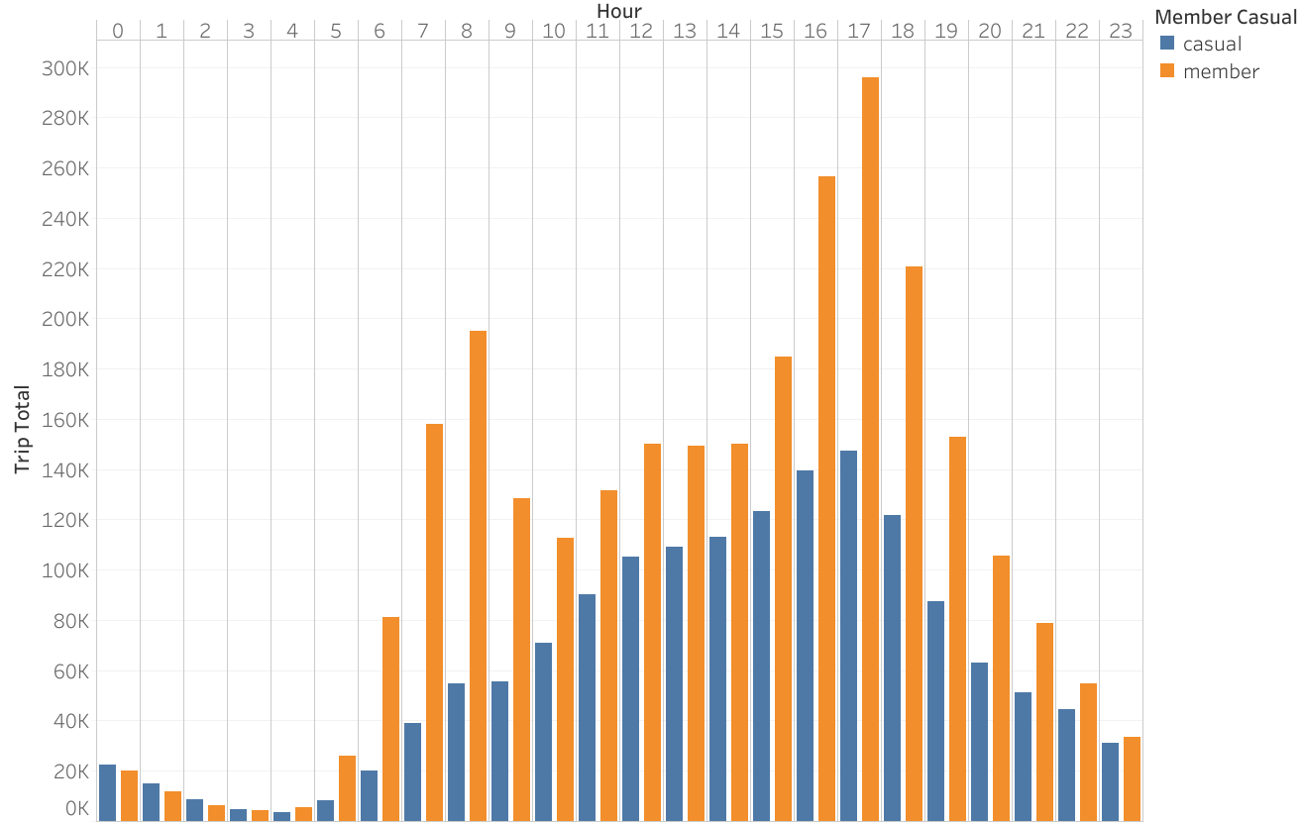
Busiest Time of a Day
Different peak times
Different patterns between 6 am to 5 pm
Notes:
from then member use soar, due to working hour starts. during midday, member use drop, but still higher than casuals, then member peak and at xiaban time.
meanwhile, casual use stable during midday till 17, and drop after that.
both dont seem to use bike much for night time, however, interesting points: more casuals than members bikes from after midnight to 6am.

Slide 14
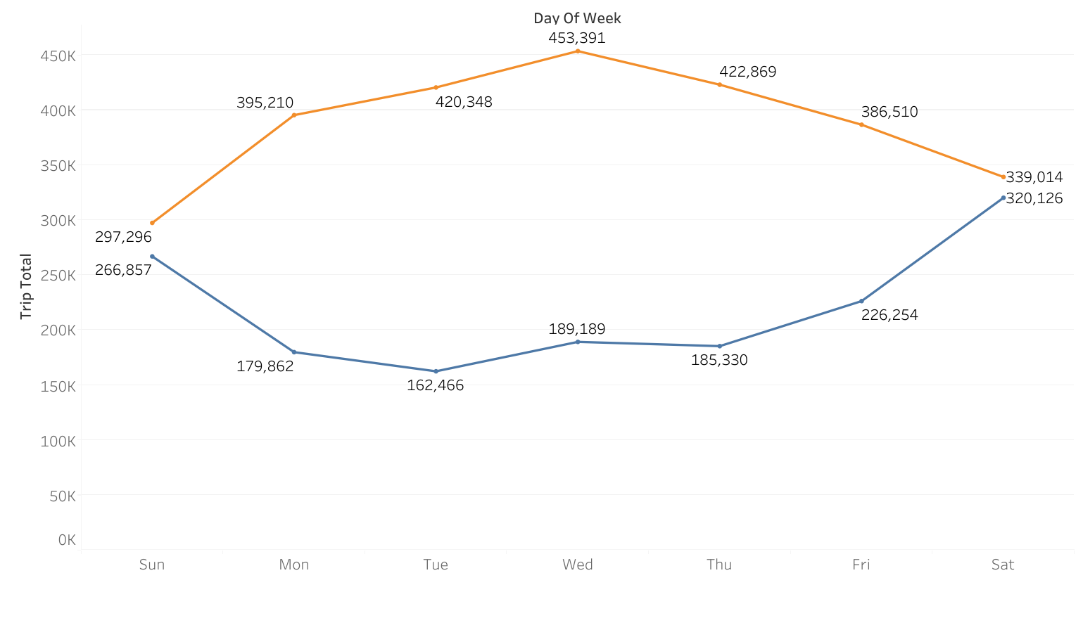
Busiest day of a week
Casuals: active on weekend
Members: Active on weekdays
Notes:
pattern hoàn toàn ngược nhau. member active trong tuần và inactive cuối tuần, casual thì ngược lại => makes sense prmote campaign cho casual, maybe gói member nhưng chỉ dành cho cuối tuần, or gói member theo kiểu set dùng bao lần trong vòng n thời gian

Slide 15
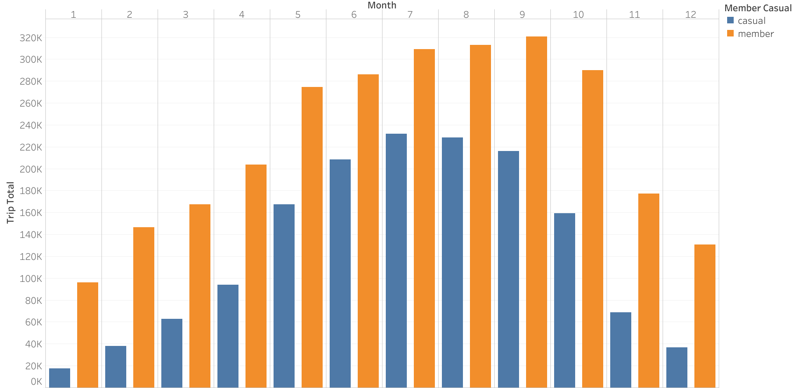
Busiest month of a year
Both share the same patterns: less active in winter time
Notes:
cả 2 có pattern giống nhau, casual còn có xu hướng tụt hơn memebr ở những tháng cuối năm => thời tiết mùa đông discourage people biking.
=> ko cần phải promote ppl convert trong mùa đông làm gì, vì ngay cả là member thì ng ta cũng ko mặn mà đi xe.

Slide 16
Trip Metrics Analysis

Slide 17
Total bike trips and trip time
Total trips by members and casuals
Total trips’ duration by members and casuals
Member_casual | total time (min) | average time per trip (min)
Casual | 36,023,367.00 | 23.54
Member | 32,493,068.00 | 11.97
Casuals make fewer trips, but spend more time for trips than members

Slide 18
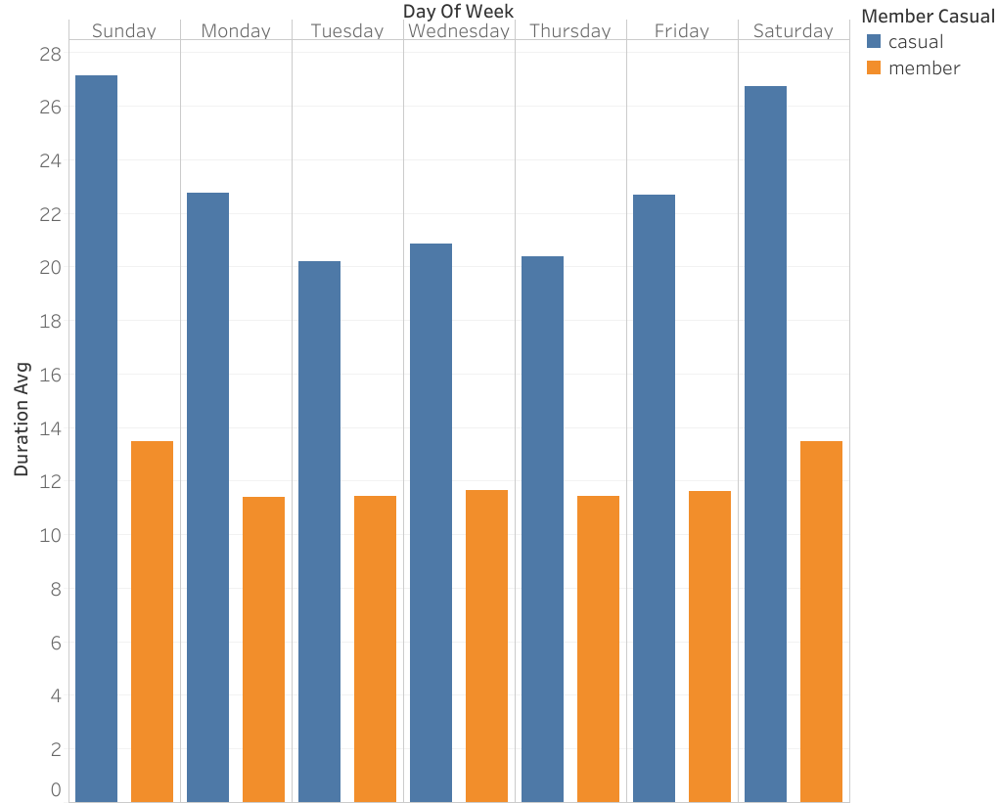
Average Trip Duration vs Day of Week
Casuals spend considerably longer time per trip on weekends, while members’ average trip durations do not vary much

Slide 19
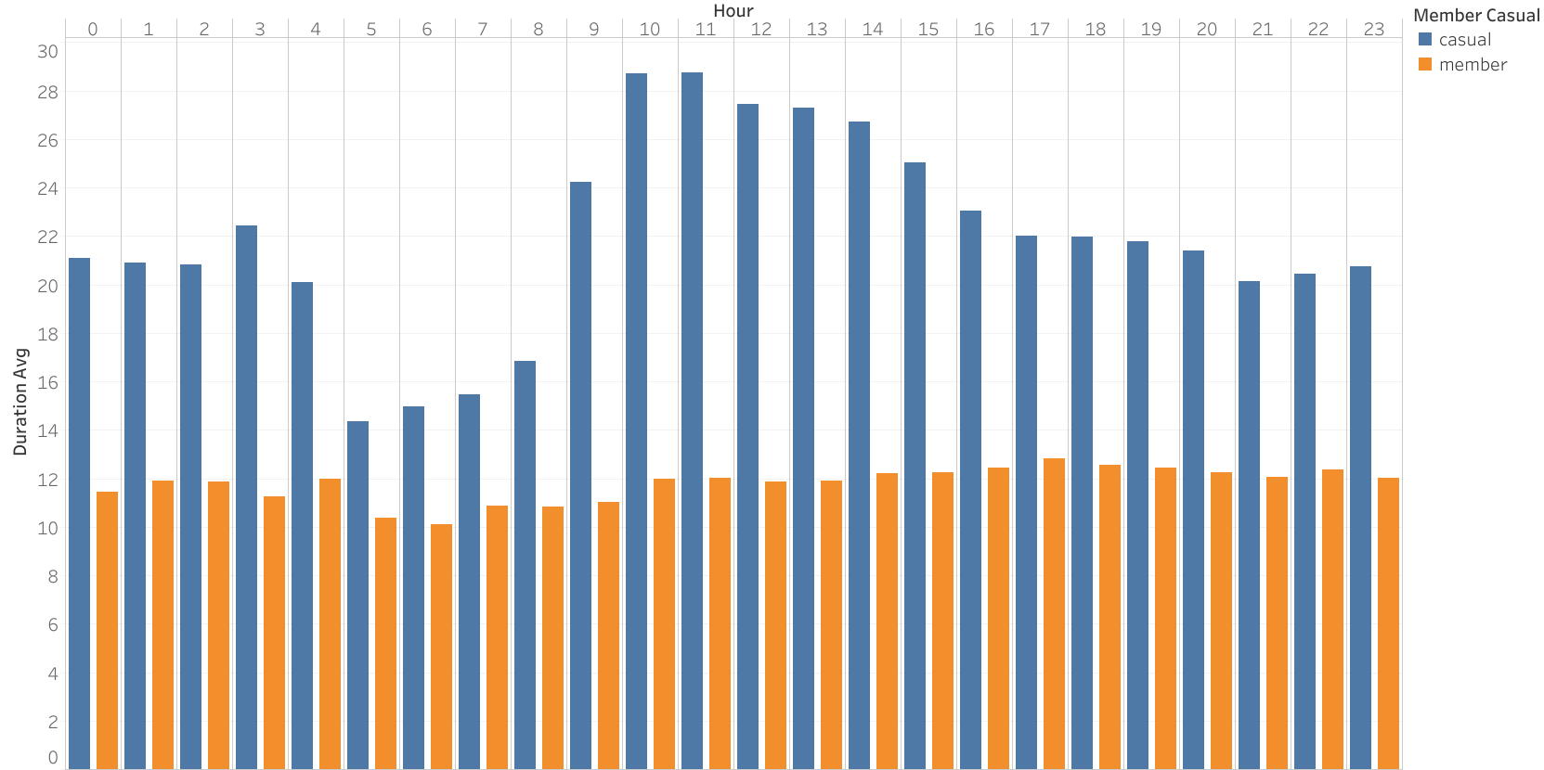
Average Trip Duration (min) vs start hour
Members spend around 12 min per trip no matter what time they bike
Casuals spend more time midday, least time in early morning

Slide 20
Time for action

Slide 21
Conclusion
User Behavior Analysis
Temporal Trends
Trip Metrics Analysis
Casuals prefer electric bikes, members go for classic bikes
Casuals make many round trips, members make more one-way trips
Most popular stations for casuals locate near attractions
Casuals are active during midday, members use peak during start and end of work hours
Casuals are more active on weekends, members on weekdays
Both casuals and members are more active in warmer months
Members make more trips than casuals, but casuals spend more time on trips in totals.
Casual spend more time on trips on weekend, members’ average trip durations do not vary much
Casuals significantly spend less time per trip in early mornings, members spend around 12 min per trip no matter what time.

Slide 22
Recommendation
User Behavior Analysis
Temporal Trends
Trip Metrics Analysis
Feature electric bikes prominently in the plan, offering exclusive discounts for round trips.
Promote this plan at stations near popular attractions, where casuals are more likely to start or end their trips.
Offer a flexible membership plan designed for casuals, featuring weekend benefits and perks for midday usage. For example, discount at attractions near popular stations
Promote this plan heavily during the warmer months when casual activity peaks, emphasizing the value of saving on frequent rides during their preferred times.
Introduce a membership plan with extended trip durations or weekend-specific benefits tailored to casuals who take longer trips, especially on weekends.
Highlight how the membership can save them money on their preferred extended ride times compared to paying as a casual.

Slide 23
Appendix

Slide 24
Link to BigQuery: Click here

